Slide 1
Challenge 3 - How Many?
Abhishek Bhandwaldar

Slide 2
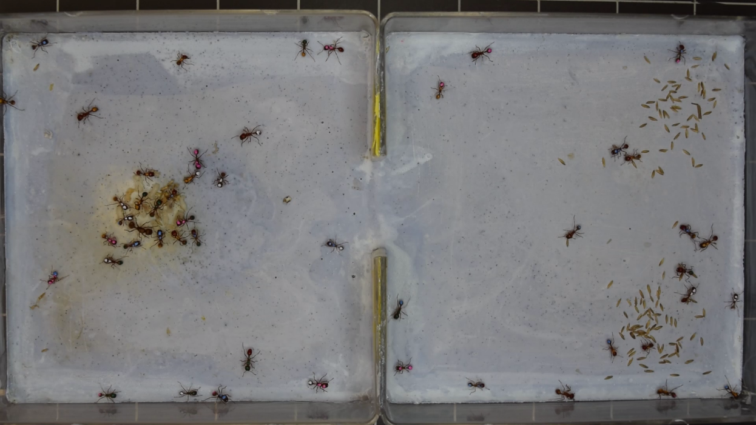
Problem Statement
Find the Number of objects in an image

Slide 3
Approach
Find Background
Subtract Background
Count Objects

Slide 4
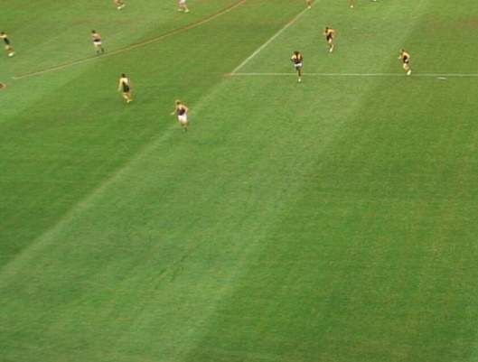
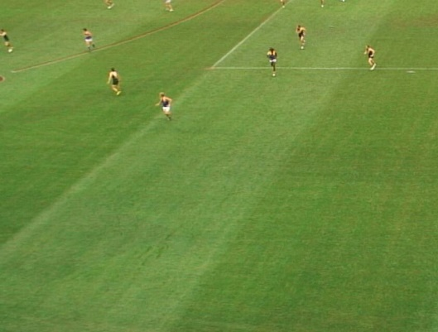
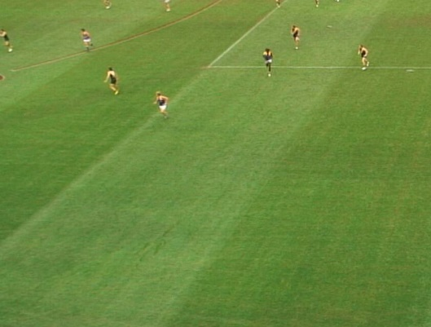
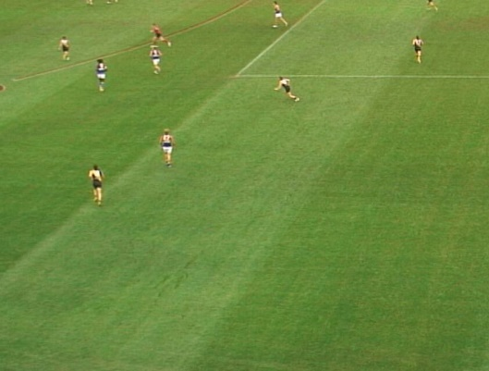
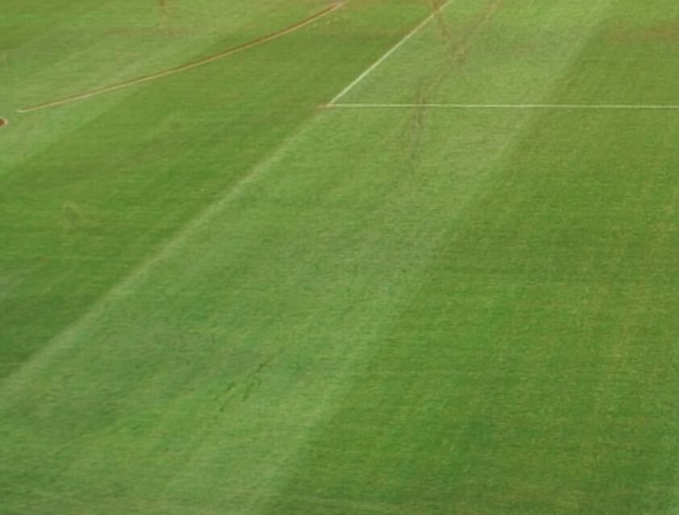
How to find Background
+
+
……………

Slide 5
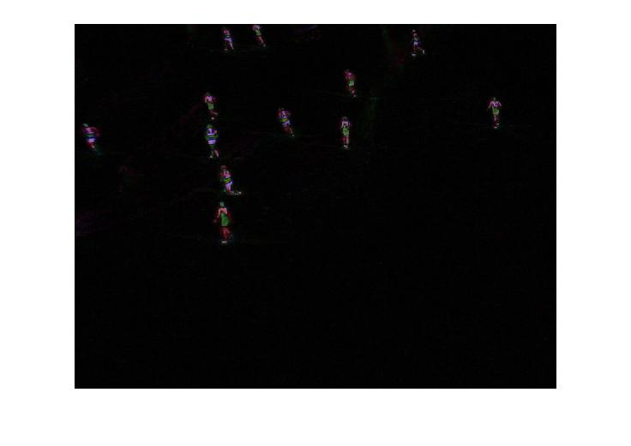
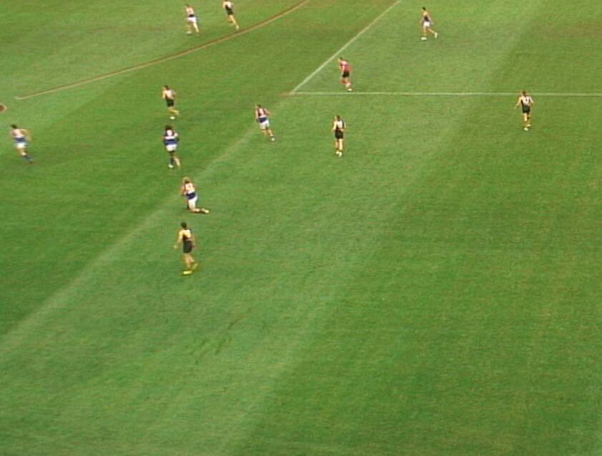
Background Subtraction
-
=

Slide 6
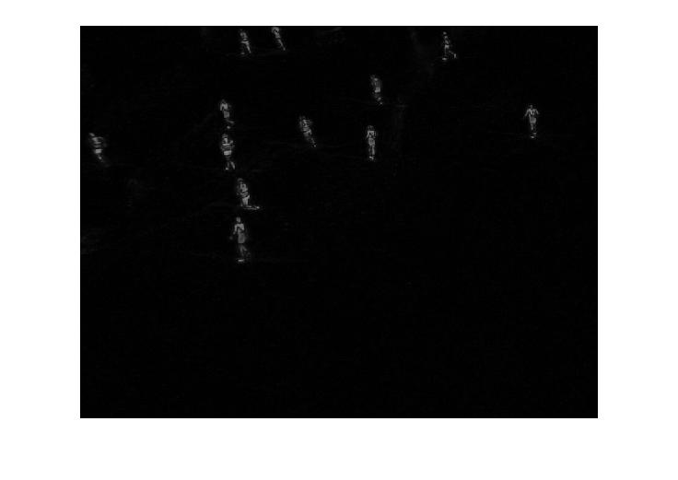
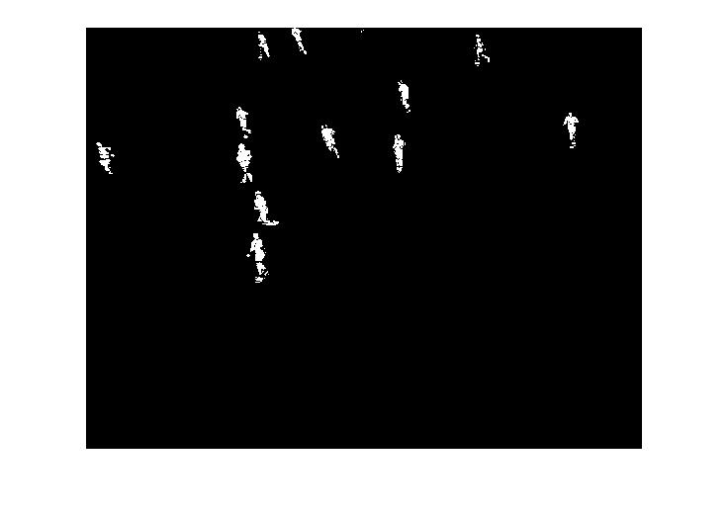
Conversion
Thresholding : image > threshold
Conversion from RGB to Grayscale

Slide 7
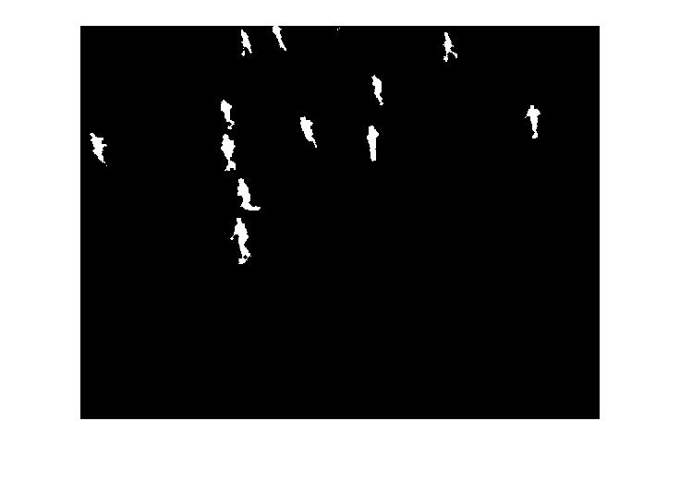
Preprocessing
Morphological Close Operation

Slide 8


Preprocessing
Small Area Removal

Slide 9
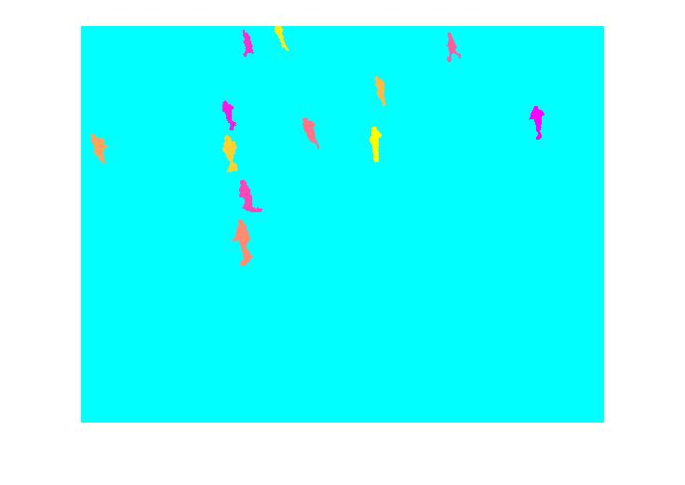
Object Counting

Slide 10
Result
Score 90
Score for video 1: 37
Score for video 2: 53

Slide 11
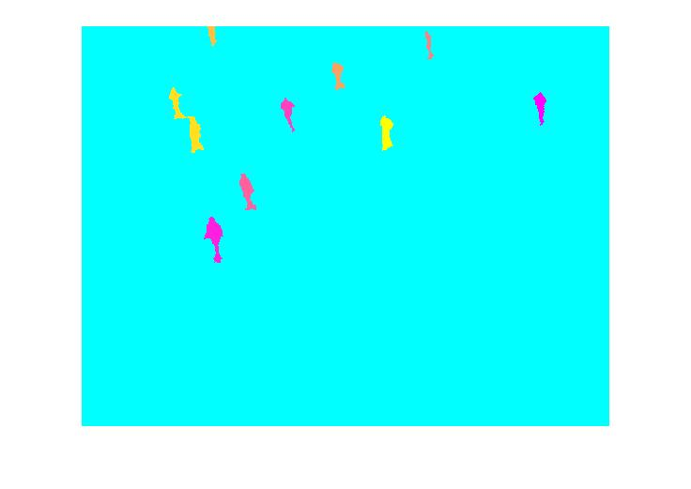
Failure
Get the Count Right but it is not counting what it is supposed to.

Slide 12
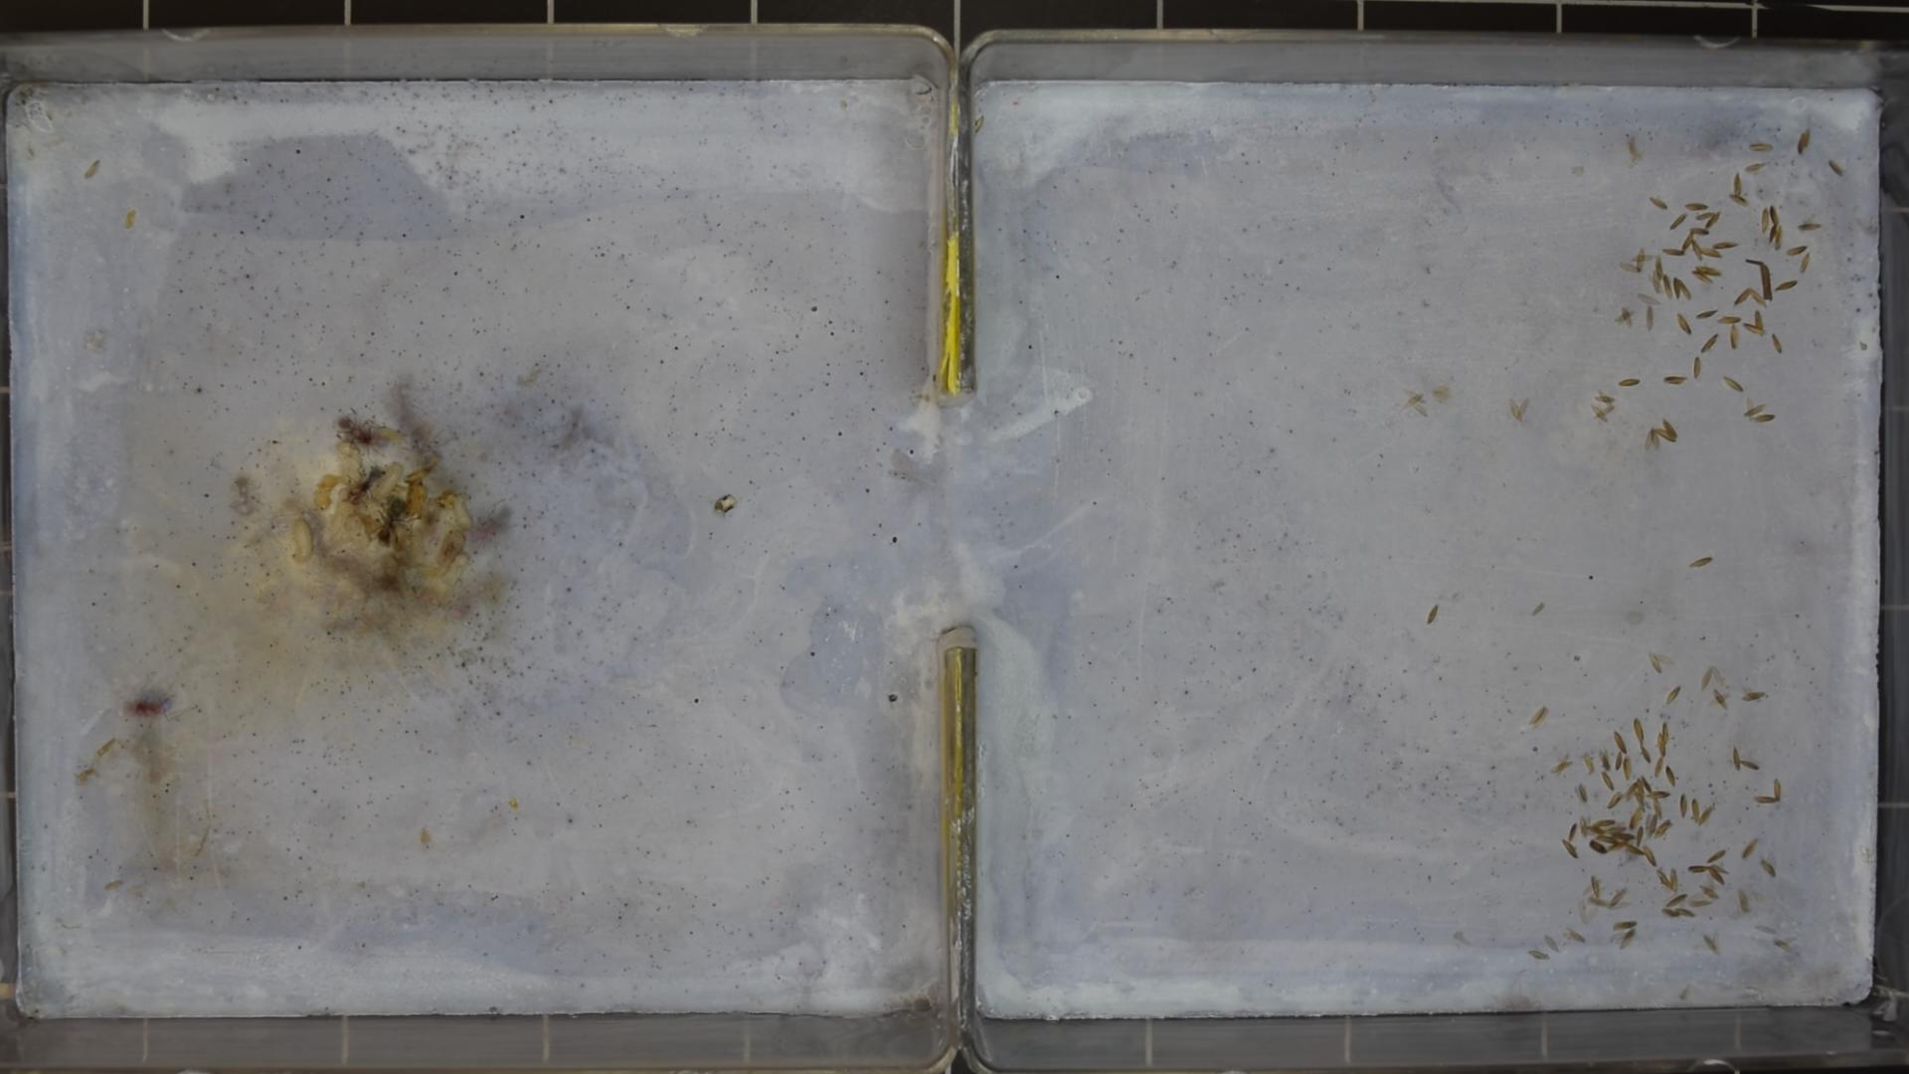
Failure
Some Ants are stationary or they don’t move that much.
Hence Background calculated is not good and hence the next steps of algorithm fails .

Slide 13
Challenge
Generalization Vs. Accuracy
Possible to get higher accuracy in one video
But then Accuracy goes down for second video
Video 1 has small, too many closely spaced objects
Video 2 has few, largely spaced objects

Slide 14
Thank You

